Slide 1
The Making of: Your Coding Journey
A copied-template presentation by Simon Curran

Slide 2

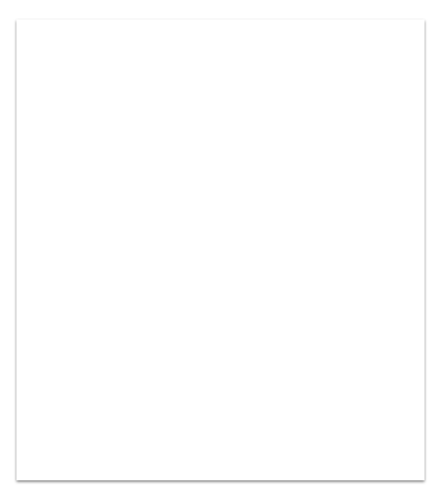
1. Brief
Demonstrate that you are able to use a range of developer tools to build a terminal application
Design Flow charts, Trello, Tests
Implement Build your app from your design
Test Test your app with predefined tests Manual testing

Slide 3
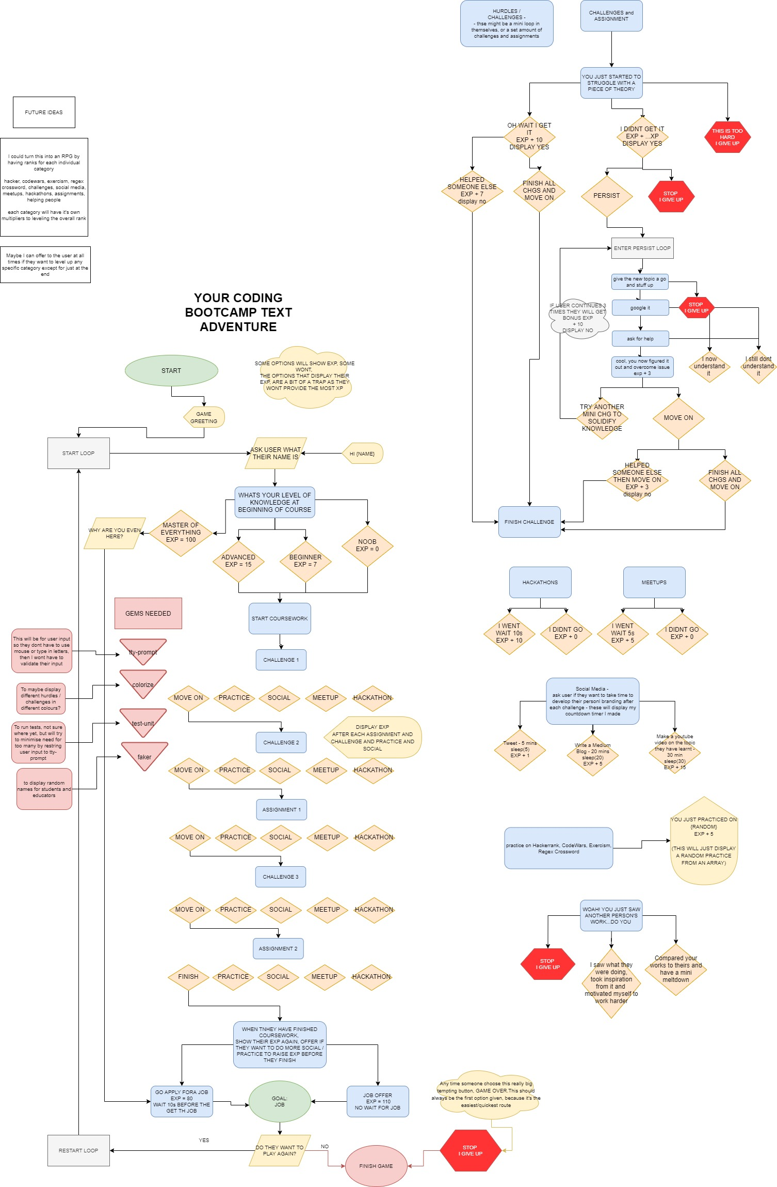
Design.
Flowchart
Draw.io

Slide 4
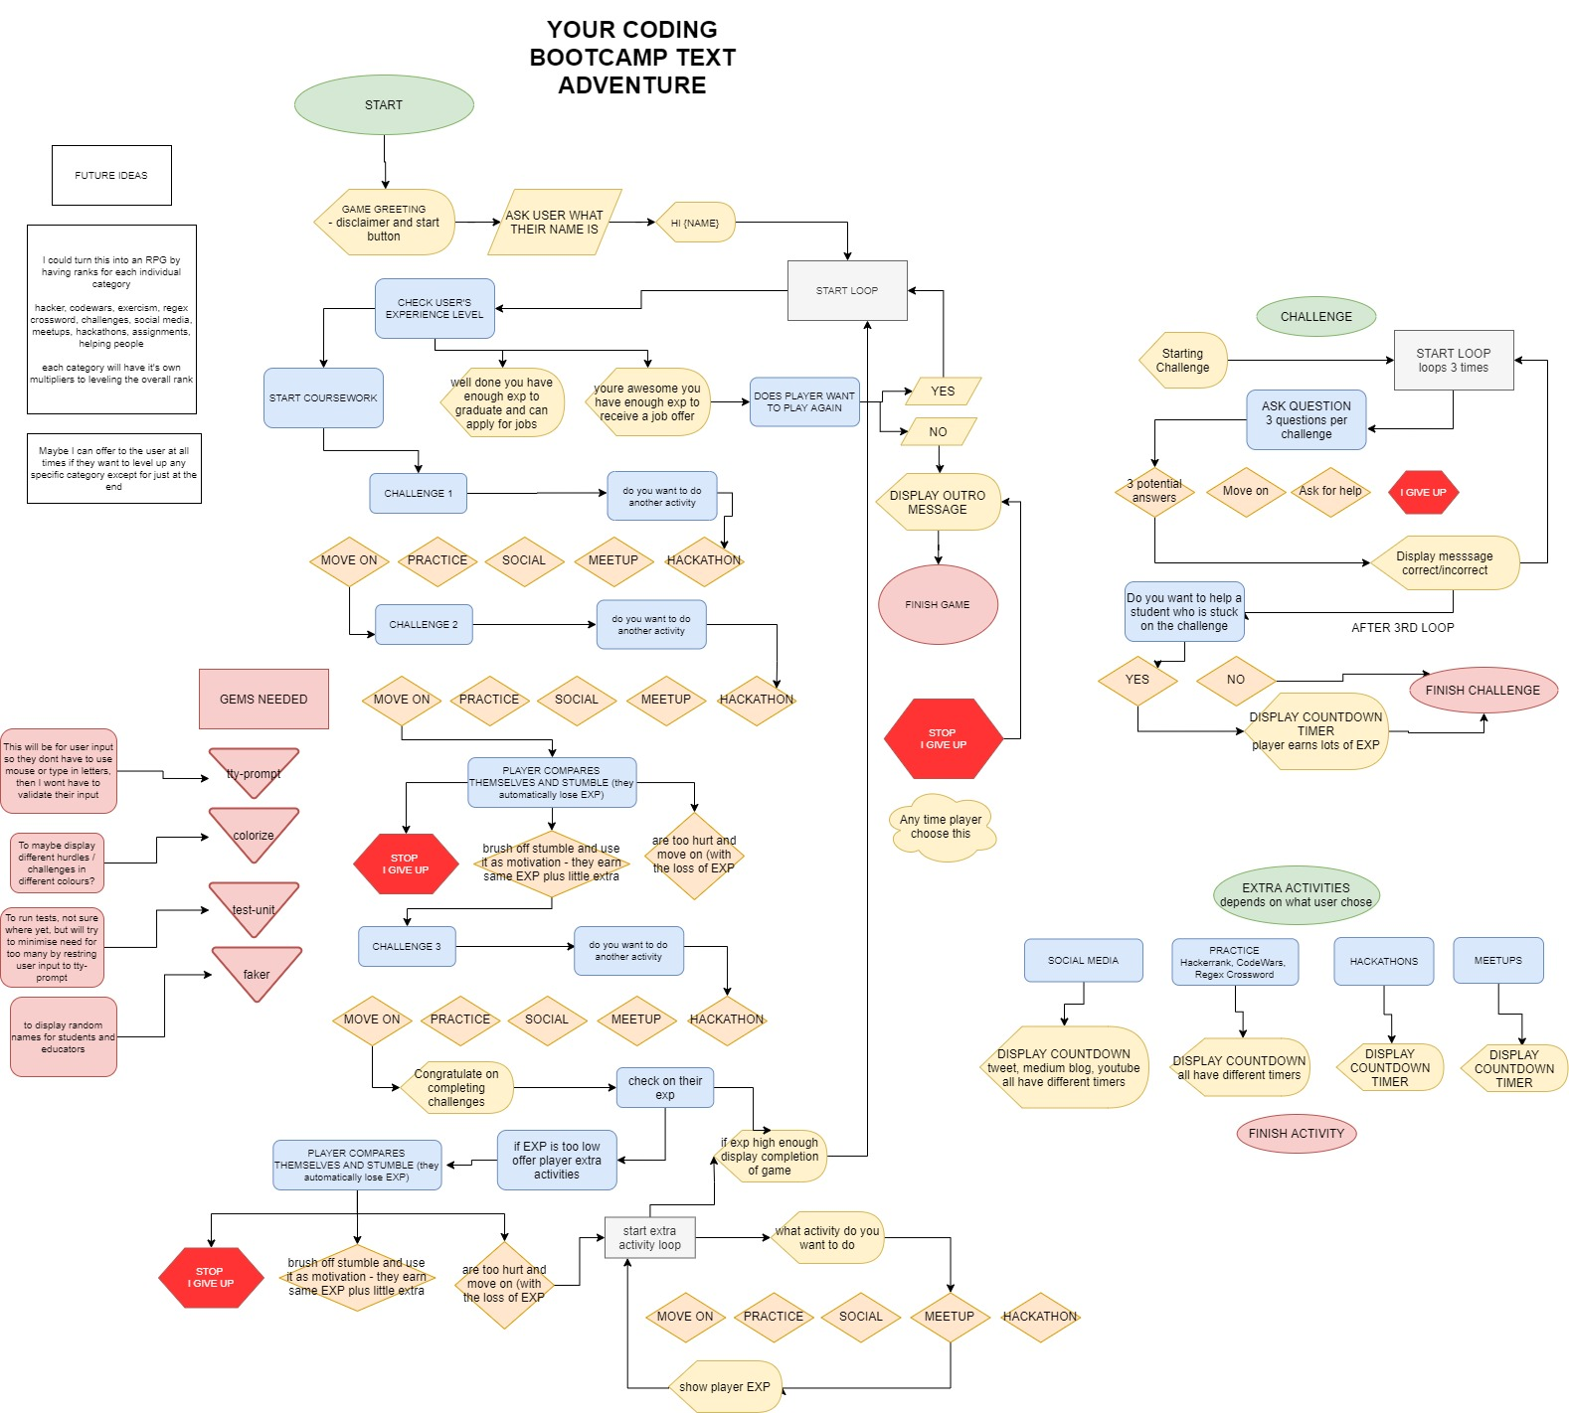
Design.
Flowchart
Draw.io

Slide 5
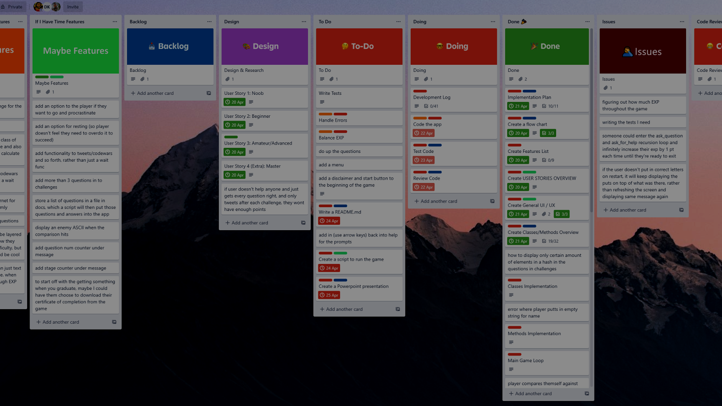
Project Management.
Trello
Tip
Don’t try reinvent the wheel with your idea
Don’t overcomplicate it
KISS
Plan as much as you can.

Slide 6

Implementation.
Build.
Fun
Why no run?!
Retry
😎
Tip
Keep your code DRY
Use variables of different scope
Error handling
Input & Output
How many times have we looked like that -->

Slide 7

Testing.
Should have written more
Saved a lot of time
Learnt a lesson
Tip
Take the educators advice and try and write tests first…
Don’t undervalue manual testing, just as important

Slide 8
2. Documentation
The backbone of your app.
Write as much as you can, flush out and outline your steps
Development Plan Lots of information
README.md Condensed information

Slide 9


TIME I THOUGHT I HAD
TIME I ACTUALLY HAD

Slide 10
